Slide 1
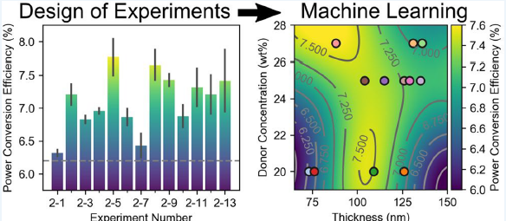
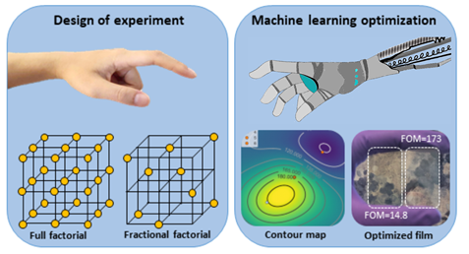


Design of Experiment and Machine Learning for the Optimization of Solar Cell Performance
Joel W. Ager, Adjunct Professor
Materials Science and Engineering, UC Berkeley
Materials Sciences Division, Lawrence Berkeley National Lab
October 14, 2019
Parts of talk adapted from presentations by Lingfei Wei, UC Berkeley and Southeastern U. Nanjing
Notes:
42 slides, 45 minutes.

Slide 2
Outline
Concepts
Design of Experiment (DOE)
Support Vector Machine Regression
Machine Learning and Cross-Validation
Case Studies
Simultaneous optimization of transparency and hole conductivity in solution-deposited CuZnS
Optimization of power conversion efficiency in solution-processed organic solar cells.
Resources
Additional reading
Open source software
Commercial software
Notes:
Goal is familiarity with concepts on the left as demonstrated by two recent studies on the right.

Slide 3
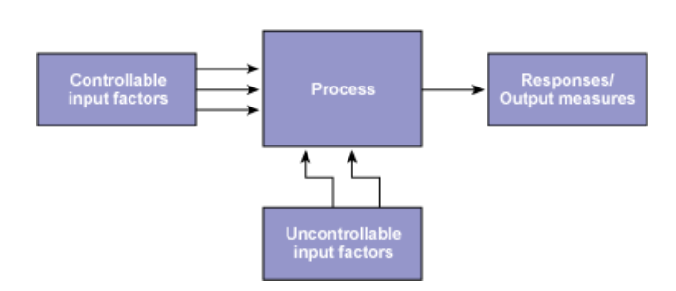
Design of Experiment
A typical experimental situation…

Slide 4
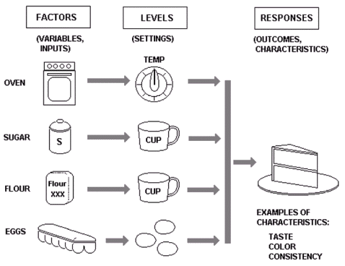
Design of Experiment Goals and Nomenclature
Goals
Achieving an optimal process output (max, min, or target)
Comparing Alternatives
Identifying the Significant Inputs (Factors) affecting an Output (Response)
Reducing Variability
Balancing Tradeoffs
Notes:
I will describe DOE from the point of view of the experimentalist.
You have a process and you would like to control the outcome. I list some goals in this context. In this talk, we will be trying to maximize something.
The experiment has factors e.g. experimental parameters. These are called “factors” by statisticians.
The values of the parameter are called “levels.” Levels – can be numeric, like temperature, or discrete, like vendor.
The outcome is called the “response.”

Slide 5
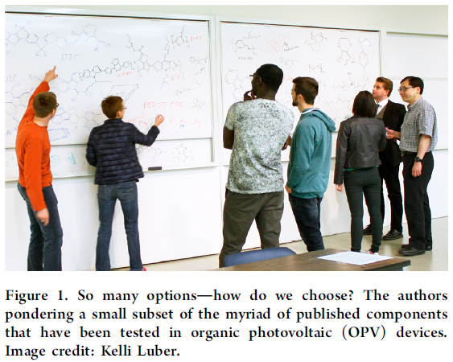
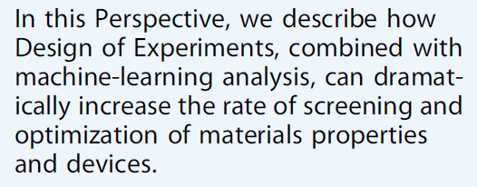
Design of Experiment
Cao, B.; Adutwum, L. A.; Oliynyk, A. O.; Luber, E. J.; Olsen, B. C.; Mar, A.; Buriak, J. M. How To Optimize Materials and Devices via Design of Experiments and Machine Learning: Demonstration Using Organic Photovoltaics. ACS Nano 2018, 12, 7434–7444.
Notes:
Experiments can be complex. So the goal of DOE is to provide guidance for navigating a complex experimental space.
If done right, one can dramatically increase the rate of optimization.

Slide 6
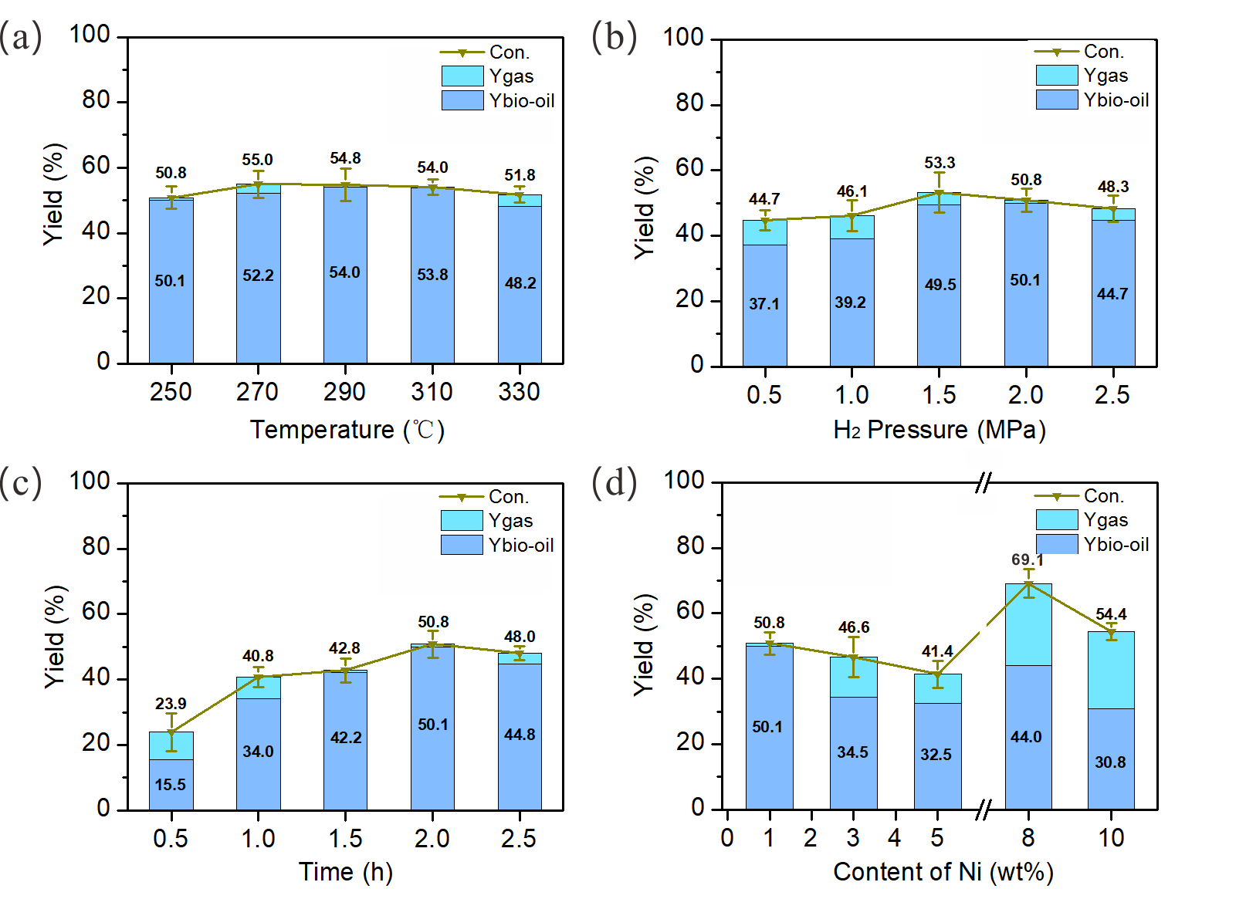
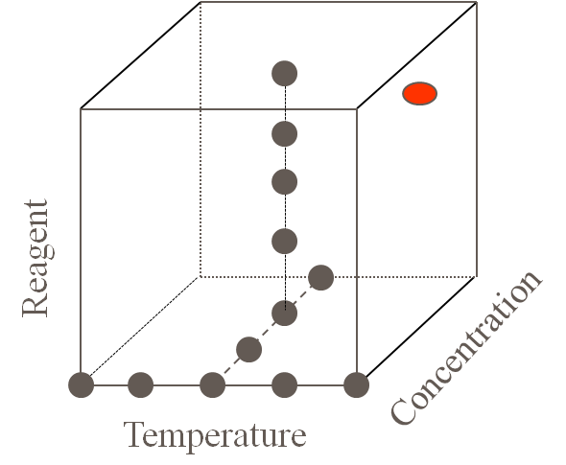
Simple DOE: “one factor at a time”
Factor z
Factor y
Factor x
The real case
Effects of reaction temperature (a), H₂ pressure (b), reaction time (c) and content of Ni in Ni/Mo₂C catalyst (d) on the catalytic hydrogenation of lignin to bio-oil (Ybio-oil) and gas product (Ygas)
Wei, Lingfei.; Bibi, R.; Zheng, Y.; Tian, W.; Chen, L.; Li, N.; Zhou, J. Catal. Letters 2018, 148, 1856–1869.
Notes:
Many experimenters use an intuitive approach, taking small steps away from base line settings.
Effects of reaction temperature (a), H₂ pressure (b), reaction time (c) and content of Ni in Ni/Mo₂C catalyst (d) on the conversion of lignin(Con.), yield of bio-oil (Y_{bio-oil}) and yield of gas product (Y_{gas}) in the catalytic hydrogenation of alkali lignin. a The reaction temperature was changed while other conditions were remain constant (2 MPa of H₂ pressure, 2 h and 1% Ni/Mo₂C). b The H₂ pressure was changed while other conditions were remain constant (290 °C, 2 h and 1% Ni/Mo₂C). c The reaction time was changed while other conditions were remain constant (290 °C, 2 MPa of H₂ pressure and 1% Ni/Mo₂C). d The content of Ni in Ni/Mo₂C catalyst was changed while other conditions were remain constant (290 °C, 2 MPa of H₂ pressure and 2 h)

Slide 7
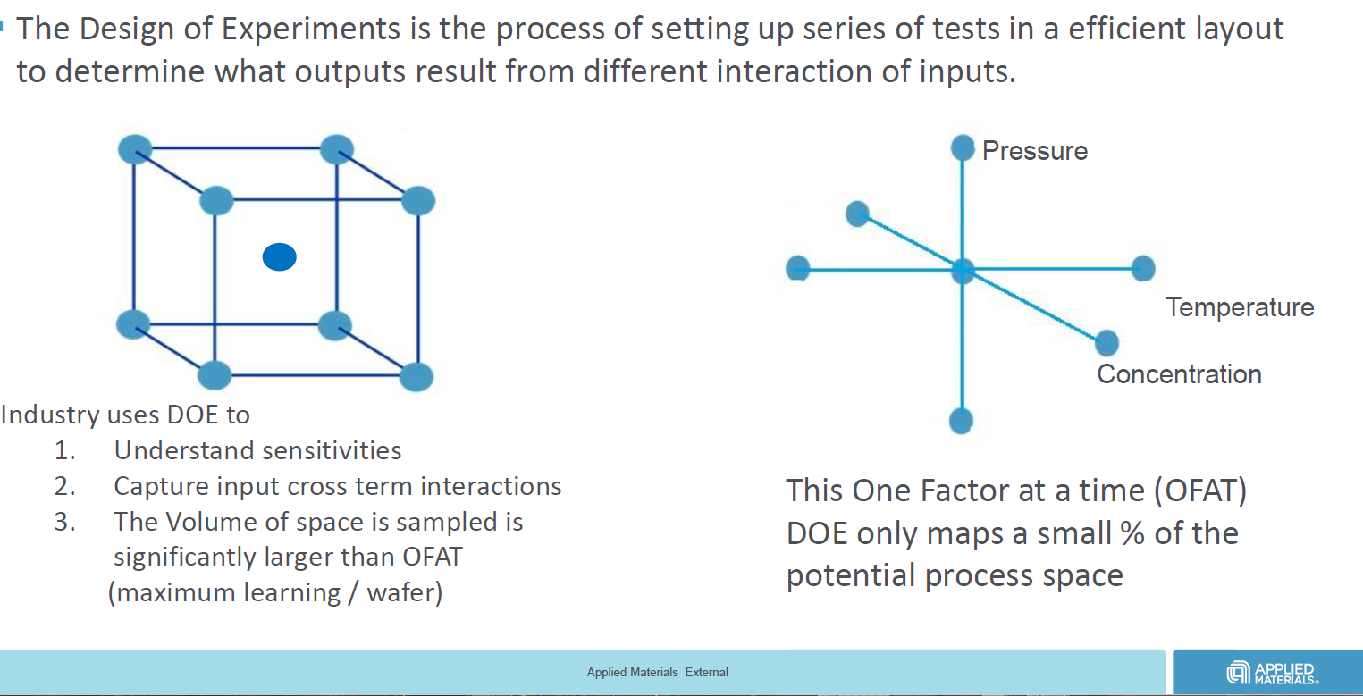
One factor at a time Not “wrong” but inefficient
Chris Olsen, Sr. Director, FEP-SSG, Applied Materials, MSE-UCLA lecture, used with permission
Notes:
DOE is used widely in industry because it is more effective at optimizing/controlling complex processes. I borrowed a slide from my colleague, who is a senior manager at AMAT, to make this point.
Those in the audience who are thinking of employment beyond the academic project which is currently supporting you might want to pay attention.

Slide 8
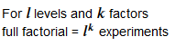
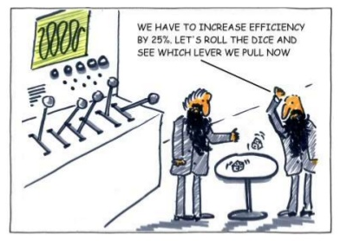
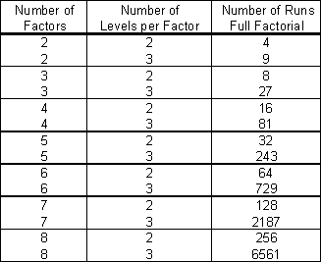

DOE Strategy
How do we get to the optimal set of parameters (levels) in the minimum number of experiments?
Notes:
Doing every possible combination of factors/levels is clearly not going to work.
So we are going to need a strategy so we don’t have to do so many experiments.

Slide 9
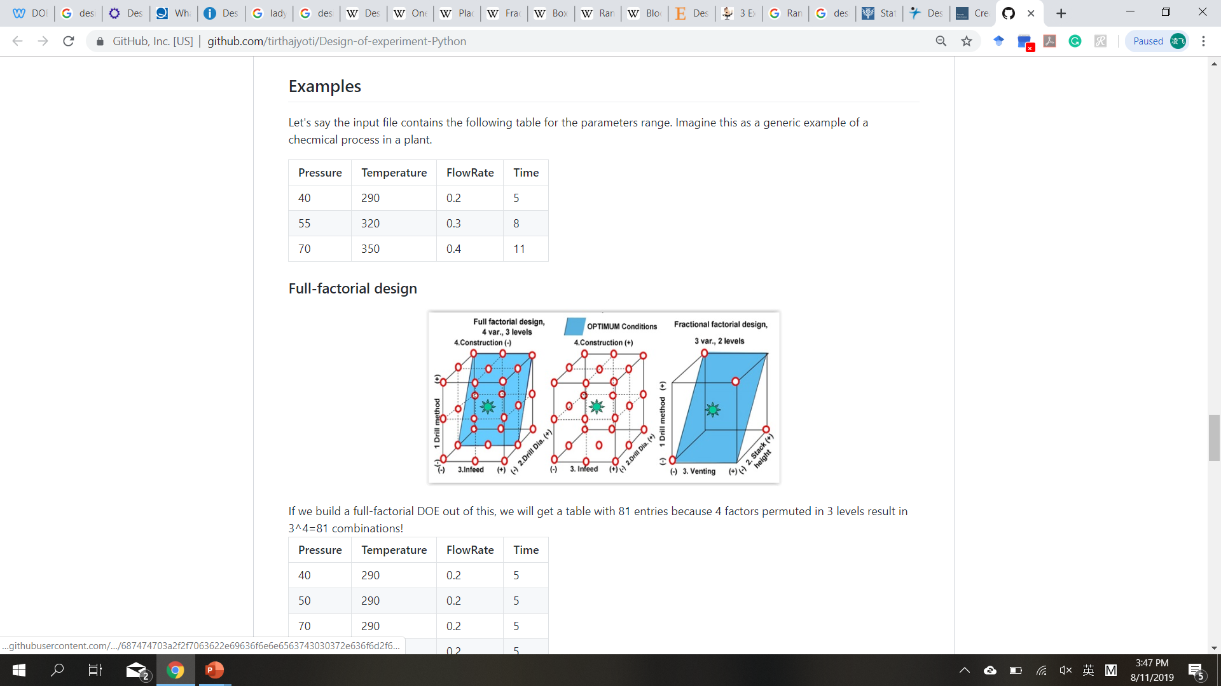
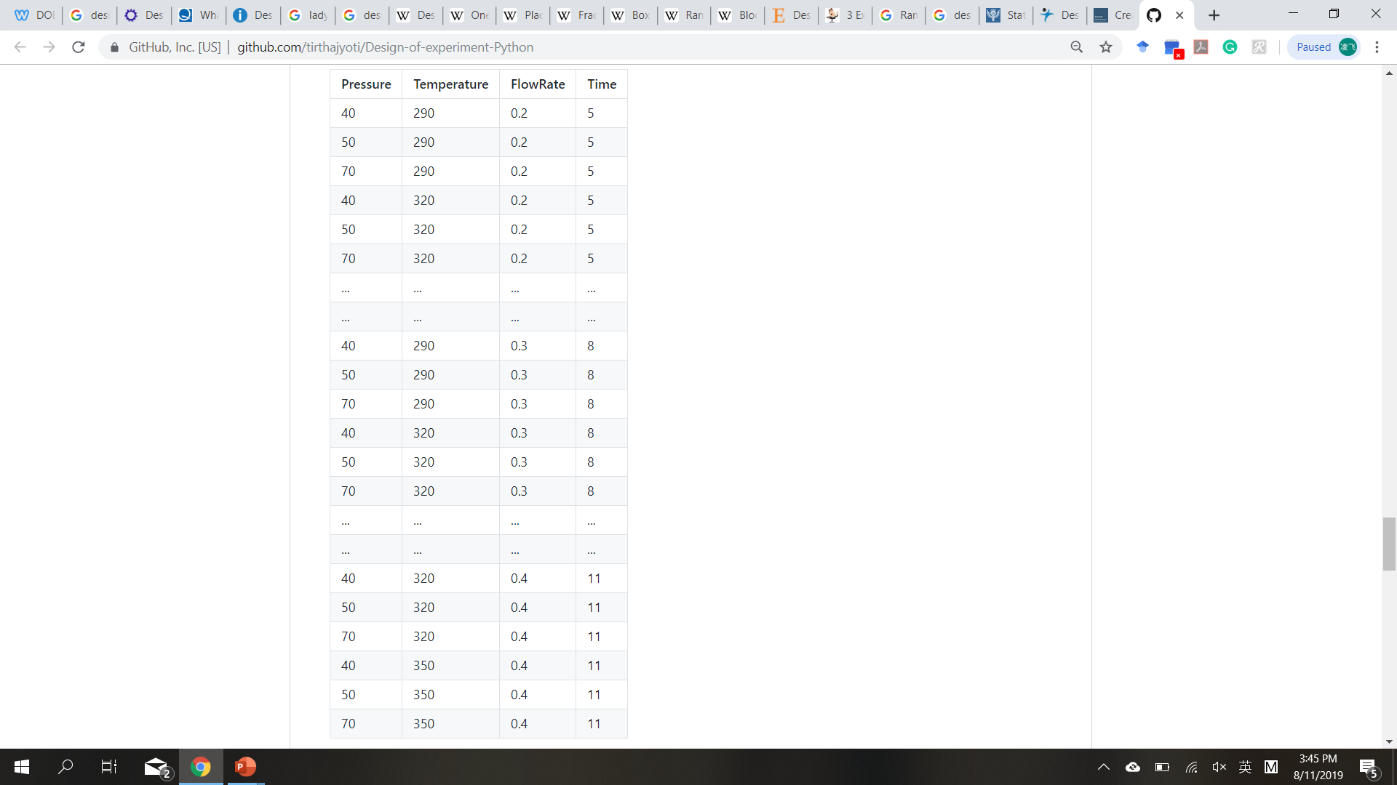
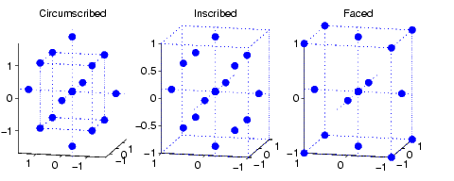
DOE options
Full factorial
3³ = 27 experiments
Simple case of 3 factors with 3 levels
Central-composite design
15 experiments
Fractional factorial
1/3 fractional = 9 experiments
Pressure | Temp | Flow
40 | 290 | 0.2
70 | 290 | 0.3
70 | 320 | 0.2
55 | 320 | 0.3
40 | 350 | 0.3
40 | 320 | 0.4
55 | 350 | 0.2
55 | 290 | 0.4
70 | 350 | 0.4
Pressure | Temp | Flow
55 | 320 | 0.2
55 | 320 | 0.4
55 | 290 | 0.3
55 | 350 | 0.3
40 | 320 | 0.3
70 | 320 | 0.3
Etc.
R packages: oa.design, ccd.design
Notes:
One factor at a time is not “wrong” but it is inefficient and one may not find the maximum in an optimization problem.

Slide 10
Outline
Concepts
Design of Experiment (DOE)
Support Vector Machine Regression
Machine Learning and Cross-Validation
Case Studies
Simultaneous optimization of transparency and hole conductivity in solution-deposited CuZnS
Optimization of power conversion efficiency in solution-processed organic solar cells.
Resources
Additional reading
Open source software
Commercial software
Notes:
Now I will introduce an optimization challenge we encountered in my research group.

Slide 11
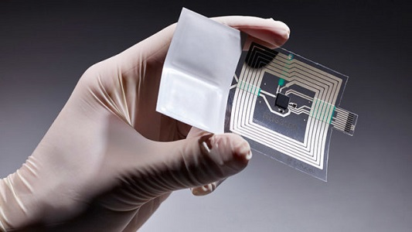
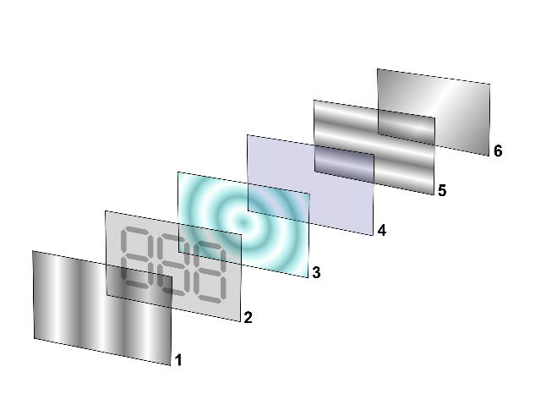

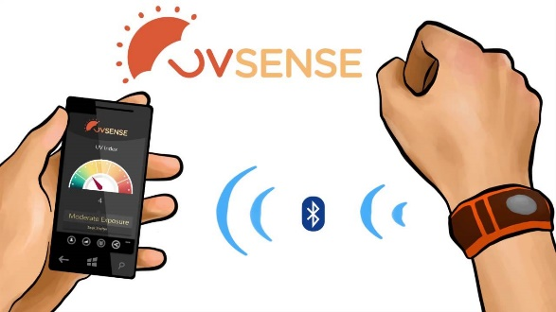

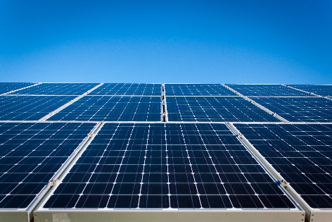
Transparent conductors
Transparent Conducting materials (TCMs)
Transparency in certain wavelength range
Small resistivity
Materials:
Metal films: Au, Ag, Cu…(t < 10 nm)
TCOs: ITO, IZO, AZO…
Conducting polymers: poly(thiophene)s (PT), Poly(fluorene)s…
Conductive carbon materials: CNTs, graphene
Applications
Touchscreen
LCD layers
UV radiation monitor
LEDs
Photovoltaics
Notes:
For flat panel displays, the higher transparency the better
For solar cells, good transparency in full length range, thermal stability
Metal films, large absorbance, poor stability
TCOs: commercialize
Electronic devices
LCD: liquid crystal displays

Slide 12
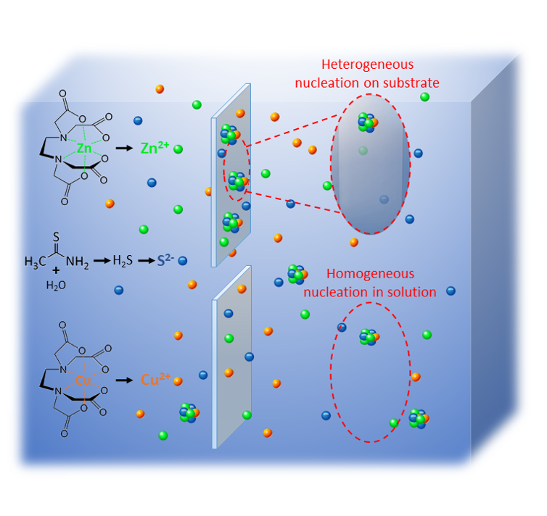
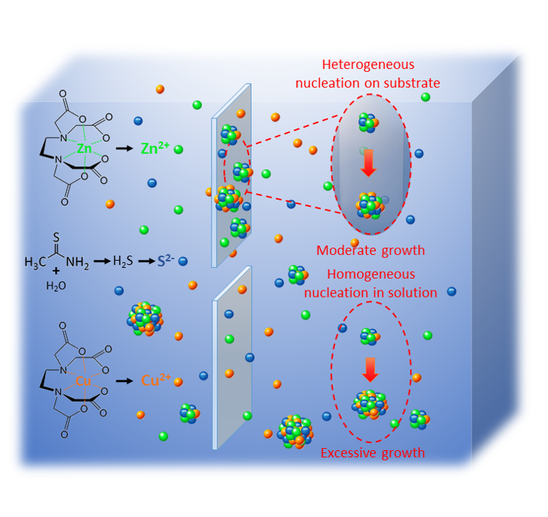
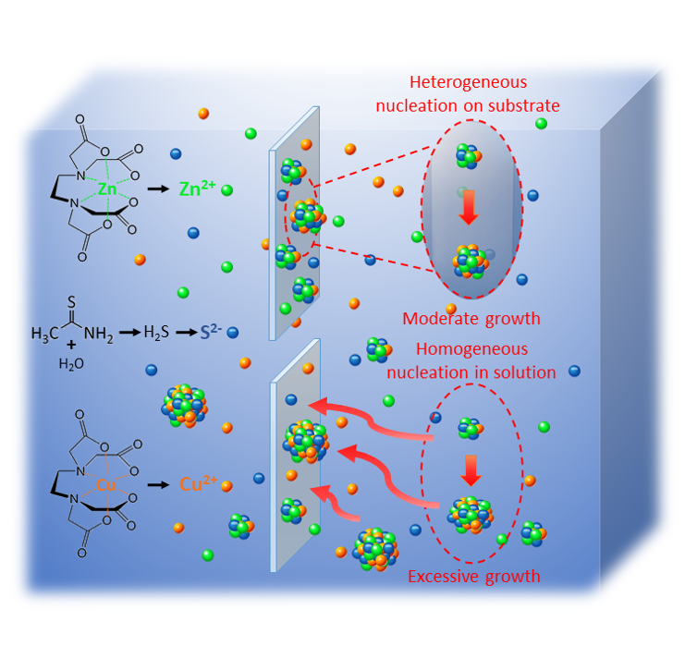
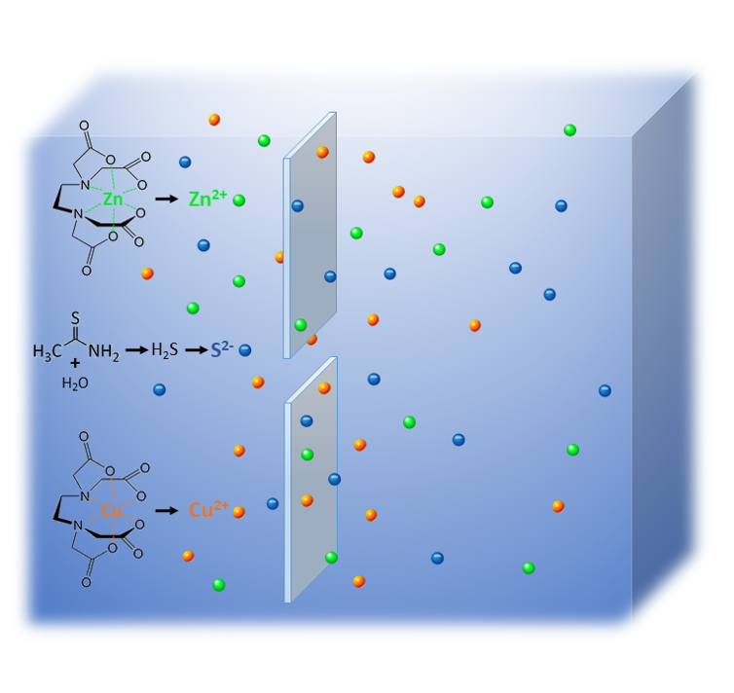
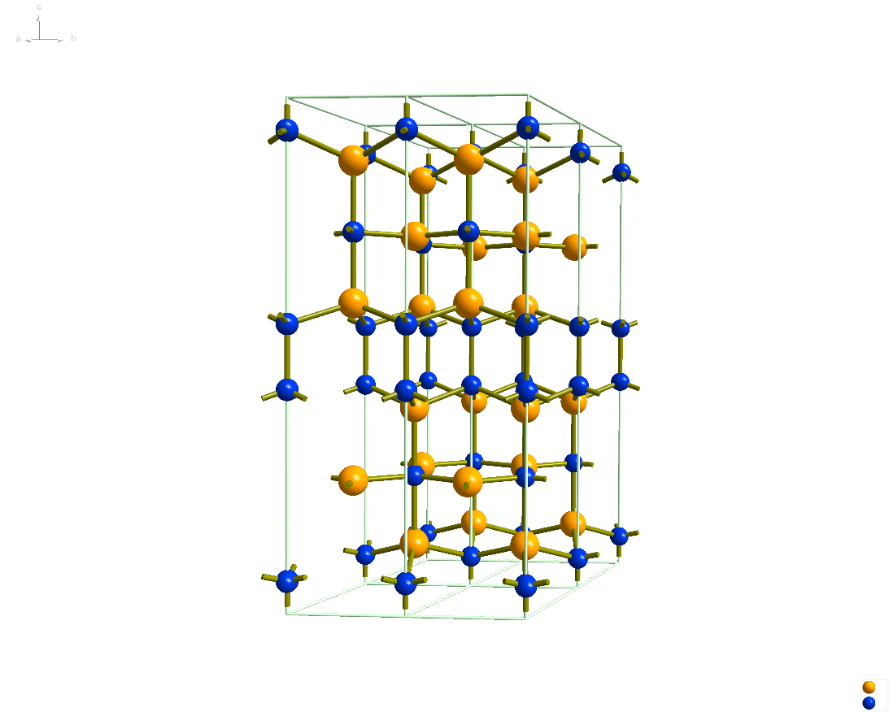
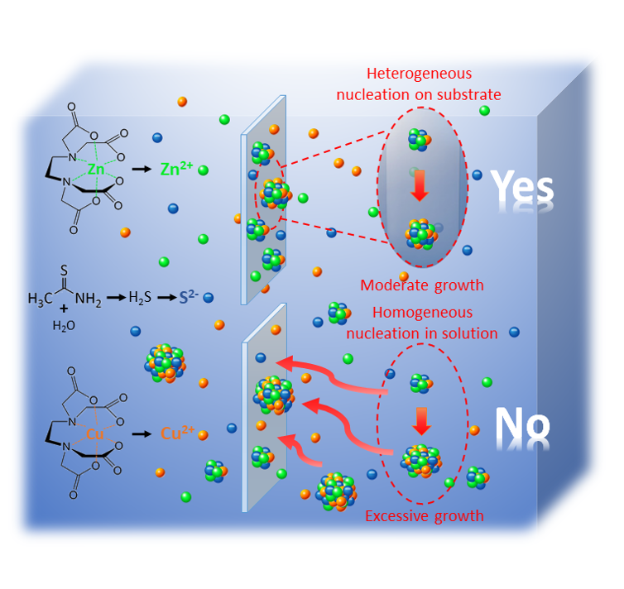
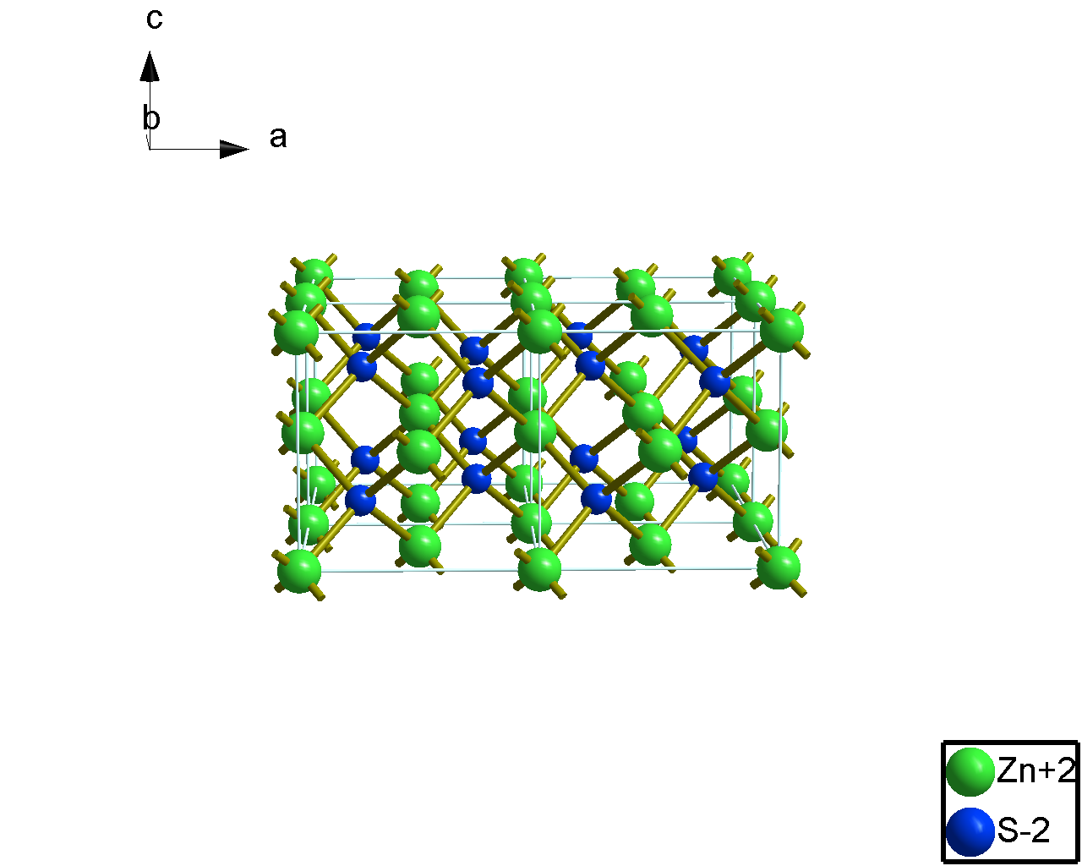
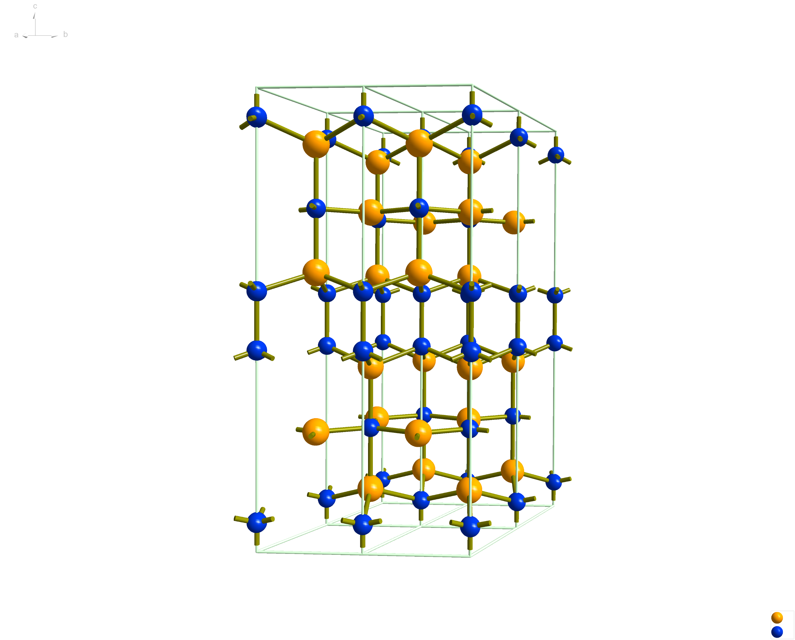
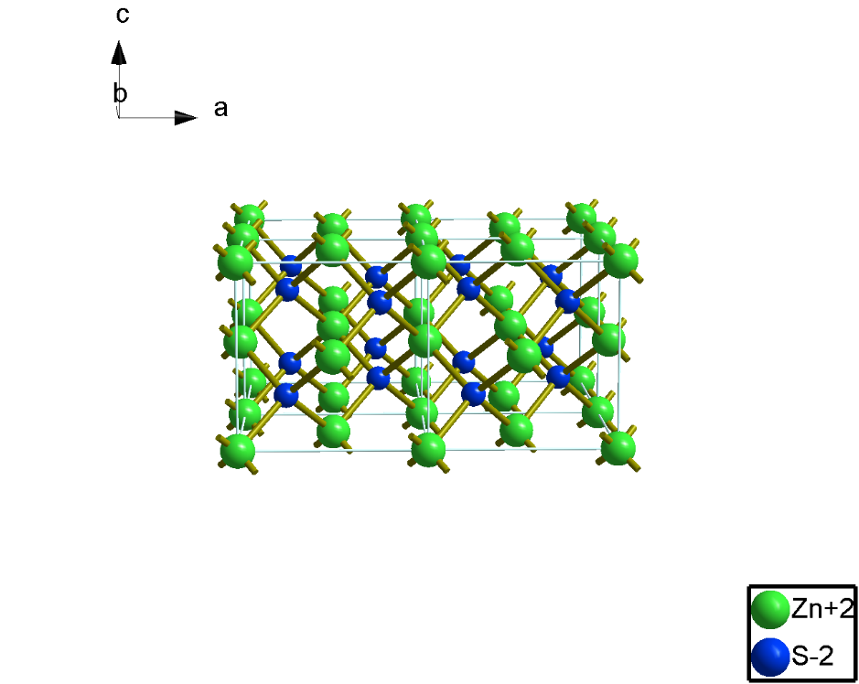
ZnS
Cu²⁺
Zn²⁺
S²⁻
CuS
Bulk CuS: p-type, E_{g}=~2.5 eV
ZnS: n-type, E_{g}=~3.6 eV
Thin film synthesis methods:
Pulsed laser deposition (PLD)
Sputtering
Electron-beam evaporation
Chemical bath deposition (CBD)
(CuS)_{x}(ZnS)_{1-x} nanocomposite:
hole conductivity >1000 S cm⁻¹
optical transmission above 70%
Cu/Zn ratio
Reaction temperature
Reaction time
Concentration of Na₂EDTA
Machine Learning
Notes:
ZnS-sphalerite
CuS-Covellite
1999, Cu doped ZnS hole conducting
Accessible operation under low temperature
Zn & Cu are chelated with the complexing agent: Na2EDTA
The complex can gradually release Zn2+ and Cu2+
Sulfur is released by H2S, formed by reaction between thioacetamide +H2O
These ions exist in solution and interact with each other
The upper case,
The lower case give a film ununiform and particles are very easy to be washed off
EDTA: to control the crystallite size efficiently via two ways: reduces aggregation of metal ions and form a concentration profile of metal ions which is more favorable to nucleation rather than crystal growth

Slide 13
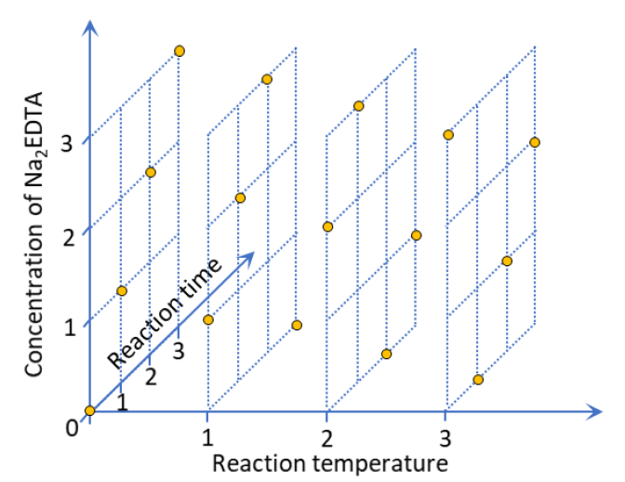
First round DOE
Factors and levels
Cu/(Cu+Zn): 2 levels, 0.65 and 0.85
Temperature: 4 levels, 60-90 C
Time: 4 levels, 30-120 minutes
Na₂EDTA concentration: 4 levels, 20-100 mM
Full factorial design = 2¹*4³ = 128 sets
1/4 Generalized subset design
16 experiments for each Cu/(Cu+Zn) level
Balanced: levels appear the same number of times
Orthogonal: levels are not correlated with other
Parameter range based on Xu, X.; Bullock, J.; Schelhas, L. T.; Stutz, E. Z.; Fonseca, J. J.; Hettick, M.; Pool, V. L.; Tai, K. F.; Toney, M. F.; Fang, X.; Javey, A.; Wong, L. H.; Ager, J. W. Chemical Bath Deposition of P-Type Transparent, Highly Conducting (CuS)x:(ZnS)1-x Nanocomposite Thin Films and Fabrication of Si Heterojunction Solar Cells. Nano Lett. 2016, 16, 1925–1932.
R package: oa.design
Notes:
We started
As we wanted to cover more of the parameter space, we using 4 levels per factor. Then made an orthogonal design.
The first round of experiments design scheme for reaction temperature, reaction time and concentration of Na2EDTA each with four levels. Cu/(Cu+Zn)=0.65 and 0.85 share the same design. Coordinates 0-3 corresponding to four levels from the lowest value to the highest value of each factor. The actual design sets are indicated by yellow balls.
Selected literature

Slide 14
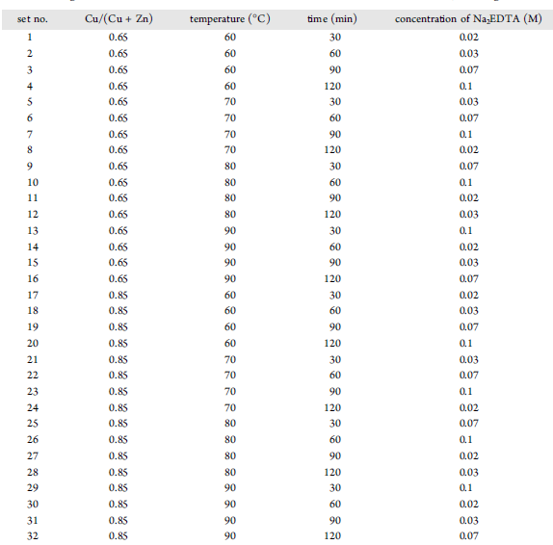
1st Run DoE
Figure of Merit (FoM, µS)
Φ_{TC}=T¹⁰/R_{s}
T: transmittance (380-780 nm) R_{s}: sheet resistance (Ω/□)
3-4 repetitions per set, 109 total experiments
Notes:
Here is what the actual design looks like
A 16 set OA design is repeated for each setting of the precursor ratio.
For each experiment we measure transparency averaged over visible and the sheet resistance.
This is used to compute an FoM which is widely used in the TCO literature.

Slide 15
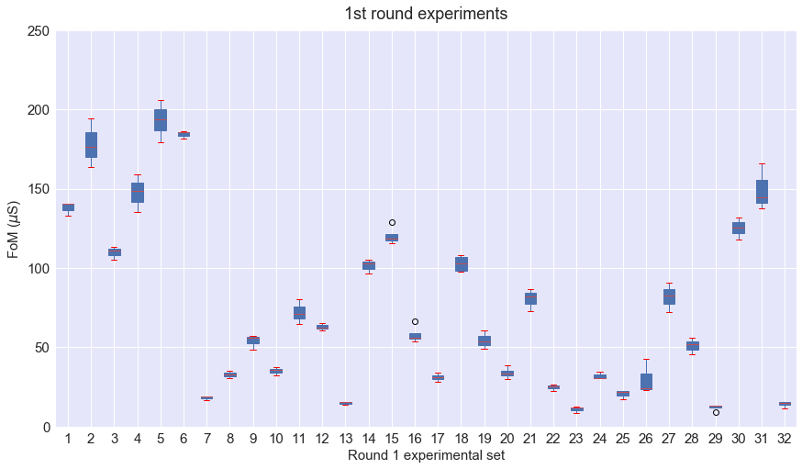
Wei, L.; Xu, X.; Gurudayal; Bullock, J.; Ager, J. W. Machine Learning Optimization of P-Type Transparent Conducting Films. Chem. Mater. 2019, 31, 7340–7350.
Notes:
For 3-4 samples in each set, FoM are with relatively small error bars, which indicates our experiment has very good repeatability
We covered a wide range of outcomes, from very bad films, FoM < 10, to very good ones, FoM near 200, which is close to the state of the art for these types of films.
There are a few outliers but not a lot.

Slide 16
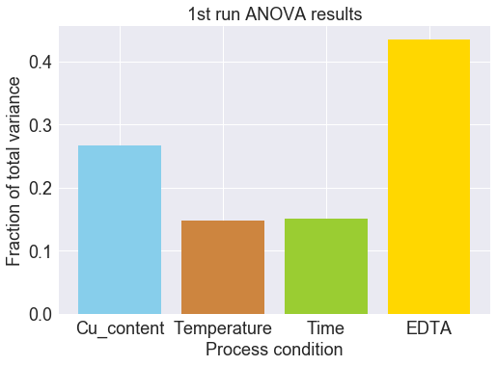
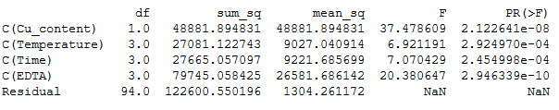
1st run statistics analysis (analysis of variance, ANOVA)
All 4 factors contribute to the observed variance in FoM
Wei, L.; Xu, X.; Gurudayal; Bullock, J.; Ager, J. W. Machine Learning Optimization of P-Type Transparent Conducting Films. Chem. Mater. 2019, 31, 7340–7350.
Notes:
For 3-4 samples in each set, FoM are with relatively small error bars, which indicates our experiment has very good repeatability
It is determined by the value of sum of squared deviation

Slide 17
Outline
Concepts
Design of Experiment (DOE)
Support Vector Machine Regression
Machine Learning and Cross-Validation
Case Studies
Simultaneous optimization of transparency and hole conductivity in solution-deposited CuZnS
Optimization of power conversion efficiency in solution-processed organic solar cells.
Resources
Additional reading
Open source software
Commercial software
Notes:
Goal is familiarity with concepts on the left as demonstrated by two recent studies on the right.

Slide 18
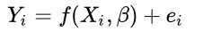
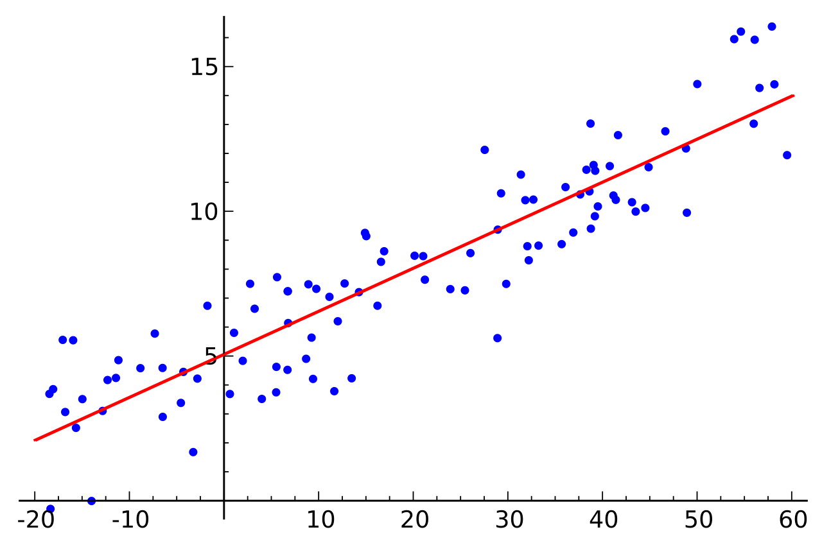
Regression analysis
We want a function f which takes our experimental settings (vector X) and predicts our experimental outcome (Y) in the presence of experimental error e.
We also might be interested in β, which are parameters in the regression model.
Regression line for 50 random points in a Gaussian distribution around the line y=1.5x+2
en.wikipedia.org/wiki/Regression_analysis
Notes:
I think we are all familiar with regression on some level.
I explain what it is, in general, and show a simple example of linear least squares regression.

Slide 19
Support vector machine regression
Dimensions
1 independent variable: line
2 independent variables: plane
>2 independent variables: hyperplane
Support vectors
Points within ε of the fit are “close enough”
Only points >ε away from the fit contribute the error (loss) function
Fitting consists of finding the hyperplane which puts as many points inside the ε tube as possible
https://www.svm-tutorial.com/2014/11/svm-understanding-math-part-2/
Notes:
We are trying to minimize least squares distance but we are ignoring points which are “close enough”
Something the e tube is known as the margin.

Slide 20
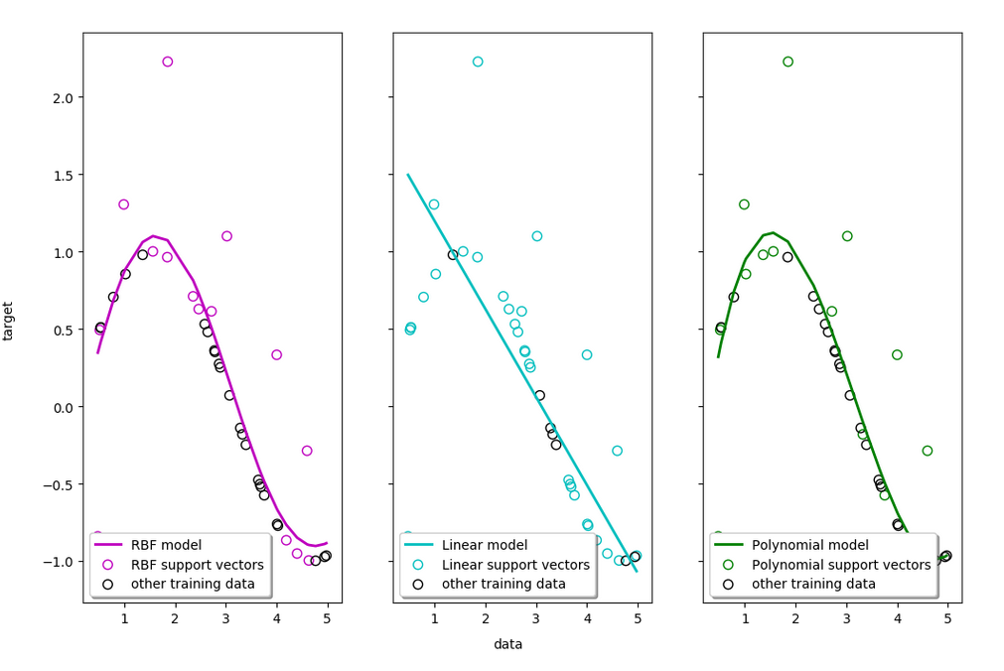
SVR kernels
ε = 0.1
Kernels govern the shape of the fit function
Gaussian aka radial basis function is good for finding maxima and minima
https://www.svm-tutorial.com/2014/11/svm-understanding-math-part-2/
Notes:
We are trying to minimize least squares distance but we are ignoring points which are “close enough”

Slide 21
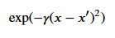
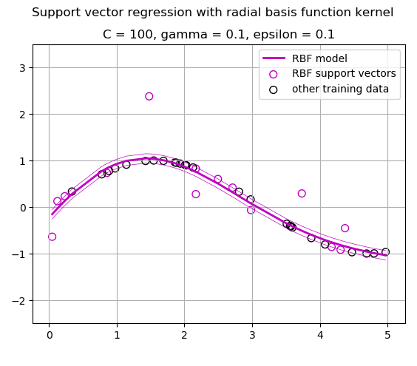
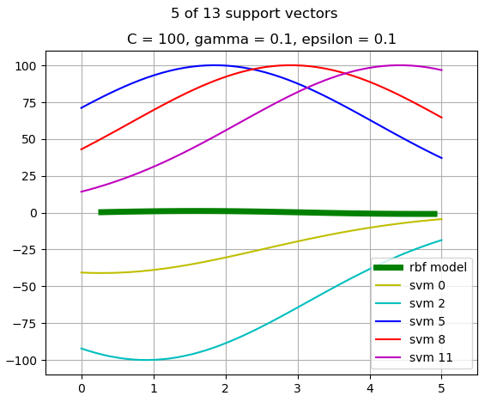
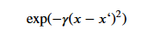
SVR model: details
Fit is sum of Gaussians centered on the support vectors with weights between –C and C

Slide 22
Outline
Concepts
Design of Experiment (DOE)
Support Vector Machine Regression
Machine Learning and Cross-Validation
Case Studies
Simultaneous optimization of transparency and hole conductivity in solution-deposited CuZnS
Optimization of power conversion efficiency in solution-processed organic solar cells.
Resources
Additional reading
Open source software
Commercial software
Notes:
Goal is familiarity with concepts on the left as demonstrated by two recent studies on the right.

Slide 23
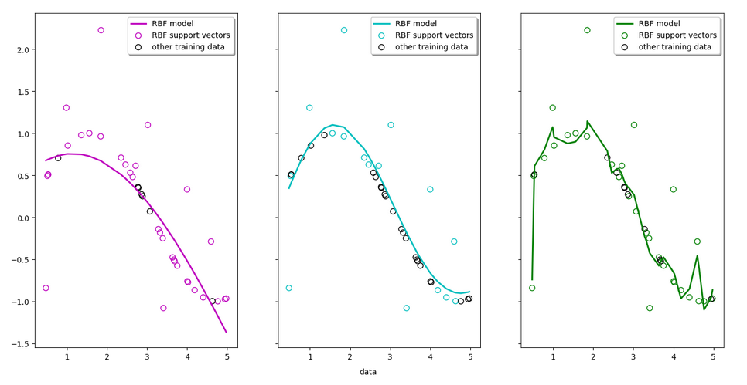
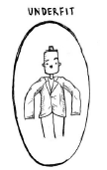
Support vector machine Overfitting and underfitting
C = 100
ε = 0.1
γ = 10
γ = 0.01
γ = 0.1
Notes:
Here are sample SVR fits for 3 values of the hyperparameter gamma.
You can see that the choice of gamma influences the fit quite a bit.
Small values of gamma lead to underfitting (Gaussians are two wide to capture the curvature of the data)
Large values lead to overfitting – sharp Gaussians can hit every point.
There is an optimal value which is just right.

Slide 24
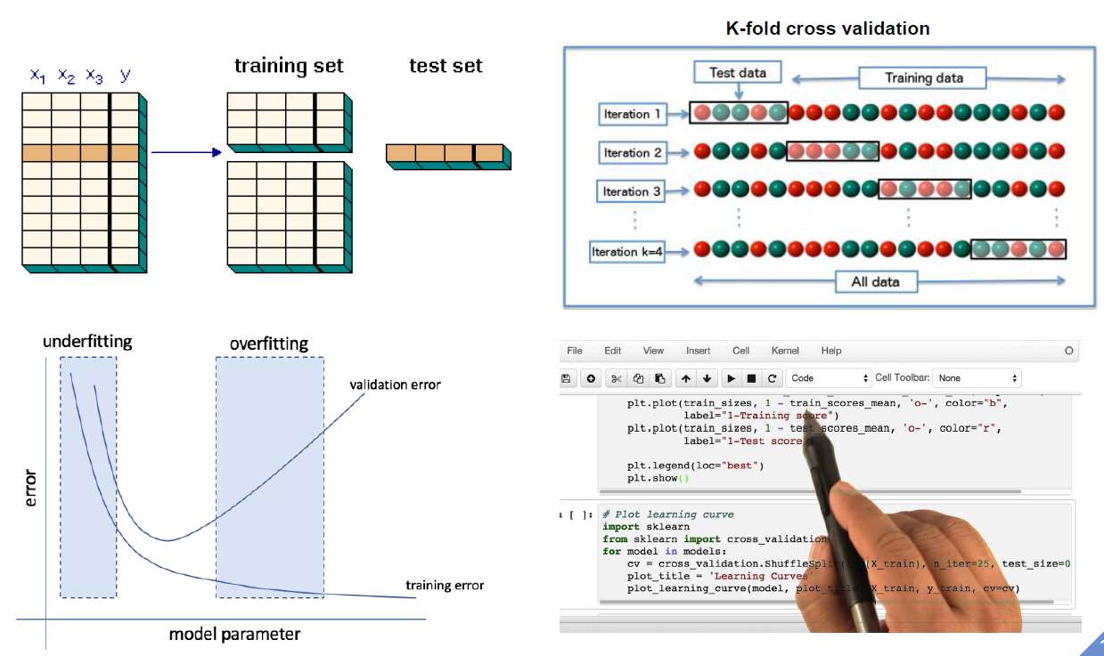
How to get the right fit? Cross validation and learning curve
Notes:
We will divide the data into a training set and a test set
We will vary a model parameter between the underfitting and overfitting regime
With the train data, we expect the error keep going down, reaching near-zero perhaps in the case of overfitting.
But new data will show a lot of error if estimated with an overfit model.
Thus the minimum in the error (loss) for the training data will find the goldilocks zone.

Slide 25
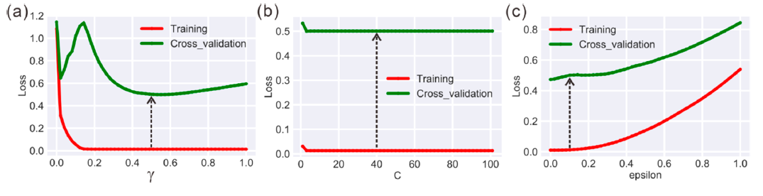
Machine Learning Cross validation for first round of experiments
10 fold cross validation on the RBF hyperparameters γ, C, and ε.
Wei, L.; Xu, X.; Gurudayal; Bullock, J.; Ager, J. W. Machine Learning Optimization of P-Type Transparent Conducting Films. Chem. Mater. 2019, 31, 7340–7350.
Notes:
There is a minimum for gamma.
A broad minimum for C
Epsilon starts underfitting for both training and cross from the start, so we use 0.1 (points more than 10% away from the fit hyperplane will be support vectors).

Slide 26
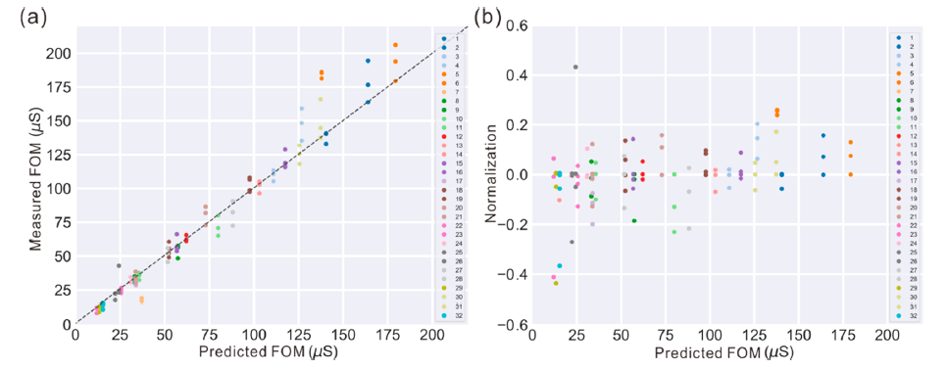
1st run SVR prediction
SVR applied to the first round: (a) measured vs. predicted FOM and (b) normalized results vs predicted FOM.
Notes:
Model works very well.
Relative error is mostly less than 20%.
And there does not seem to be a bias for low or high FOM.

Slide 27
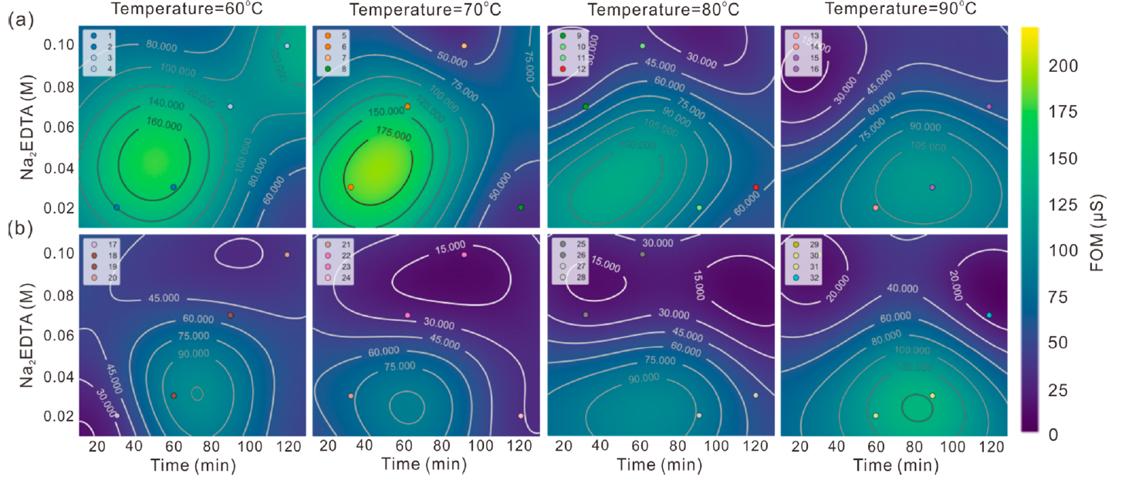
1st run contour maps
Cu/(Cu + Zn) = 0.65
Cu/(Cu + Zn) = 0.85
Wei, L.; Xu, X.; Gurudayal; Bullock, J.; Ager, J. W. Machine Learning Optimization of P-Type Transparent Conducting Films. Chem. Mater. 2019, 31, 7340–7350.
Notes:
Now we are in a position to learn from our experiments.
There is an interesting range at the lower precursor concentration, about 70 C temperature and 40-80 mM EDTA
Contour maps of predicted FOMs as a function of deposition time and Na2EDTA concentration from the first round: (a) Cu/(Cu + Zn) = 0.65 and (b) Cu/(Cu + Zn) = 0.85. FOM scale and contours were chosen to emphasize the full range of the predicted FOMs.

Slide 28
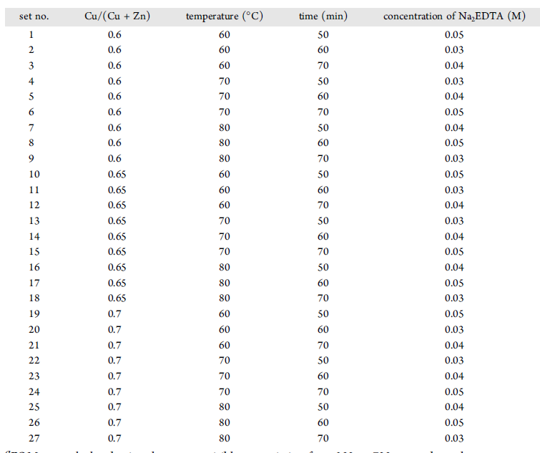
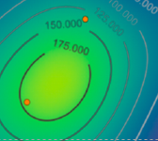
2nd Run DoE
Cu content: 0.6, 0.65, 0.7
Temperature: 60, 70, 80 ºC
Reaction time: 60, 70, 80 min
Na₂EDTA concentration: 0.02, 0.03, 0.04 M
1/3 fractional factorial, balanced and orthogonal
27 Sets & 92 samples in total

Slide 29
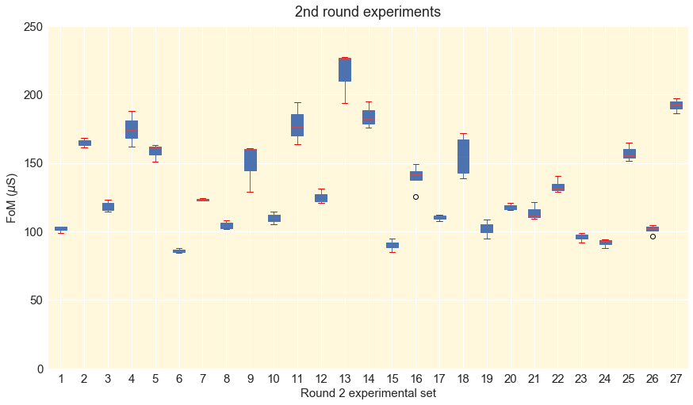
Notes:
We have improve to over 200 in this second round. Set 13 looks very good. As do 14 and 11

Slide 30
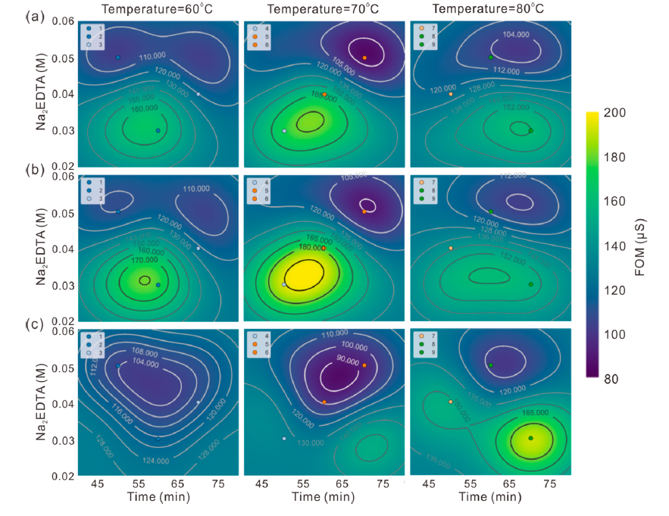

Cu/(Cu + Zn) = 0.60
Cu/(Cu + Zn) = 0.70
Cu/(Cu + Zn) = 0.80
Notes:
Found the maximum! Settings 13 and 14.
Not that we need to shift the numbers.

Slide 31



optimized
Non-optimized
Notes:
Briefly, optimized films have smaller grains are more transparent and perform better as HTLs for solar cells (with Si) and transparent diode (with ZnO).

Slide 32
Outline
Concepts
Design of Experiment (DOE)
Support Vector Machine Regression
Machine Learning and Cross-Validation
Case Studies
Simultaneous optimization of transparency and hole conductivity in solution-deposited CuZnS
Optimization of power conversion efficiency in solution-processed organic solar cells.
Resources
Additional reading
Open source software
Commercial software
Notes:
Can go very quickly through the OPV example

Slide 33




DOE and ML for OPVs
Cao, B.; Adutwum, L. A.; Oliynyk, A. O.; Luber, E. J.; Olsen, B. C.; Mar, A.; Buriak, J. M. How To Optimize Materials and Devices via Design of Experiments and Machine Learning: Demonstration Using Organic Photovoltaics. ACS Nano 2018, 12, 7434–7444.
Notes:
Just make a montage, same process flow.

Slide 34
Key Concepts
Design of Experiment (DOE) Optimal experimental parameters (factors) in the least amount of time
Analysis of Variance (ANOVA) Determine which factors affect outcome of experiment
Support Vector Regression (SVR) Method to fit multi-dimensional data without the need for a physical model
Cross-validation Machine learning method to find optimal hyperparameters
Notes:
List some key concepts.

Slide 35
Outline
Concepts
Design of Experiment (DOE)
Support Vector Machine Regression
Machine Learning and Cross-Validation
Case Studies
Simultaneous optimization of transparency and hole conductivity in solution-deposited CuZnS
Optimization of power conversion efficiency in solution-processed organic solar cells.
Resources
Additional reading
Open source software
Commercial software
Notes:
Goal is familiarity with concepts on the left as demonstrated by two recent studies on the right.

Slide 36


Additional Reading
Making mono-disperse quantum dots
Discovering superhard materials
Voznyy, O.; Levina, L.; Fan, J. Z.; Askerka, M.; Jain, A.; Choi, M.-J.; Ouellette, O.; Todorović, P.; Sagar, L. K.; Sargent, E. H. Machine Learning Accelerates Discovery of Optimal Colloidal Quantum Dot Synthesis. ACS Nano 2019, acsnano.9b03864.
Mansouri Tehrani, A.; Oliynyk, A. O.; Parry, M.; Rizvi, Z.; Couper, S.; Lin, F.; Miyagi, L.; Sparks, T. D.; Brgoch, J. Machine Learning Directed Search for Ultraincompressible, Superhard Materials. J. Am. Chem. Soc. 2018, 140, 9844–9853.
Notes:
Two examples of using ML for experimental studies.

Slide 37

Notes:
An example

Slide 38


Software resources – open source
Python
Anaconda
Machine learning packages: pandas, sklearn, tensorflow, keras
Github:
JWA site
Lingfei Wei site
Design of Experiment, Tirthajyoti Sarkar
R: DoE.base
(Full Factorials, Orthogonal Arrays and Base Utilities)
Grömping U (2018). “R Package DoE.base for Factorial Experiments.” Journal of Statistical Software, 85(5), 1–41. doi: 10.18637/jss.v085.i05.
1/2 fractional factorial
Notes:
Open sources resources for machine learning

Slide 39


Commercial Software
JMP® 10 Design of Experiments Guide: https://www.jmp.com/support/downloads/pdf/jmp1001/doe_guide.pdf
Copyright © 2012, SAS Institute Inc., Cary, NC, USA
Notes:
JMP used in industry.

Slide 40


Commercial Software
JMP® 10 Design of Experiments Guide:
Notes:
JMP used in industry. Shows how it integrates DOE and analysis of the results.

Slide 41

Thank you

Slide 43


DOE terminology
Fisher's principles:
Comparison
Randomization
Statistical replication
Blocking
Orthogonality
Balance
Factorial experiments
(1890-1962)
Ronald Fisher
Notes:
The Arrangement of Field Experiments (1926) and The Design of Experiments (1935)
a certain lady could distinguish by flavour alone whether the milk or the tea was first placed in the cup
-randomization gives each individual unique chance to be examined in a research, so that can largely reduce human bias; At the same time, people should also be careful about randomization when using small sample size. Randomization can bring unreal results.
-statistical replication: performing the same combination run more than once, thus repeat experiments can further strengthen the experiment's reliability and validity
-Blocking is to avoid any unwanted variations in the input or experimental process.
-Orthogonality ensures that all specified parameters can be estimated independent of any other

Slide 44

DOE Methodology
Fractional factorial design
Number of factors
5 factors, 2 levels experiment
I ^{k − p}
2 ⁵ = 32
2 ⁵⁻² = 8
Fraction size
Full factorial design
1/4 fractional factorial design
Number of levels of factors
2³⁻¹ fractional factorial
Fold-over
2³ full factorial
Notes:
A design with p such generators is a 1/(l^{p}) fraction of the full factorial design

Slide 45





DOE Methodology
Plackett–Burman design (orthogonal two-level experimental design )
Criterion - each combination of levels for any pair of factors appears the same number of times, throughout all the experimental runs.
Notes:
Mostly used two level factorial design
presented in 1946, while working in the British Ministry of Supply
A complete factorial design would satisfy this criterion, but the idea was to find smaller designs.
orthogonal two-level experimental design

Slide 46


DOE Methodology
Latin Square
Reduced Latin Square
Equivalence classes of Latin squares
Orthogonal Latin Square
Notes:
an n × n array filled with n different symbols, each occurring exactly once in each row and exactly once in each column
normalized Latin square

Slide 47

DOE Guidelines
To determine: the factors to be tested; the levels of those factors; the structure and layout of experimental runs, or conditions.
To consider: unexplained variables; Uncontrollable factors (noise factors); correlation between factors.
To decide a DOE method.
To collect data: conduct experiments, minimize experimental error.
To analyze results using statistical methods (F-test, ANOVA).
To conclude results, to determine practical significance and to make recommendations.

Slide 48

Choice of parameters

Slide 49








Machine learning
Unsupervised
Feature
extraction
Machine learning
algorithm
Classification
Supervised
Regression
(predictive model)
New data
Step-by-step
➢ Machine learning types
➢ Machine learning algorithms (Support Vector Machine, SVM)
➢ SVM: mathematics, kernel, hyperparameters
➢ Overfitting & Underfitting: cross validation
➢ Machine learning in materials sciences

Slide 50

Machine learning types
Notes:
We are going to do supervised learning here.

Slide 51

Machine learning algorithms

Slide 52


DOE Methodology
Generalized subset design
3 factors (4,3,2) experiment
Full factorial design: 4 x 3 x 2 = 24
1/3 GSD: 1/3 x 28 = 8
Notes:
As we wanted to cover more of the parameter space, we using 4 levels per factor. Then made an orthogonal design.

Slide 53
DOE Methodology Fractional factorial design
5 factors, 2 levels experiment
Number of factors
2 ⁵ = 32
2 ⁵⁻² = 8
I ^{k − p}
Full factorial design
1/4 fractional factorial design
Fraction size
Number of levels of factors
2³⁻¹ fractional factorial
Fold-over
2³ full factorial
Notes:
A design with p such generators is a 1/(l^{p}) fraction of the full factorial design

Slide 54

Support vector machine Kernels and their parameters
https://www.svm-tutorial.com/2014/11/svm-understanding-math-part-2/
Notes:
We are trying to minimize least squares distance but we are ignoring points which are “close enough”

Slide 55

FoM comparison for p-TCMs

Slide 56
Software resources
Python: https://github.com/tirthajyoti/Design-of-experiment-Python
Copyright (c): 2018-2028, Dr. Tirthajyoti Sarkar, Sunnyvale, CA 94086

Slide 57
Outline
Basics and motivation for use of statistics
Univariate comparison of means (Student’s t-distribution)
Analysis of Variance (ANOVA)
Design of Experiment – Description of basic designs
Example using JMP software
NOTE:
Experimental design methods are well designed into software
Great Resource: https://www.itl.nist.gov/div898/handbook/index.htm

Slide 58
Three purposes for conducting an experiment:
1) Examine an observed behavior ⇒ no model
2) Test a model ⇒ proposed model Y = f(x_{1,} x_{2,} …x_{n})
3) Monitor a Process ⇒ known model Y = f(x_{i}) ± ε
What’s so hard about this?
> There is always and error, ± ε :
Model is incomplete
Have not accounted for all input factors, X_{i}.
Uncertainty in inputs and measurements
Uncertainty means you can only assign a probability to your results and conclusions.

Slide 59
Errors follow a probability distribution
Single Value (univariate) example:

Slide 60
Probability Distribution & Density Functions
Poisson
Binomial
Exponential
Uniform
Normal (Gaussian)
Default assumption for error:
Most frequently encountered
Good approximation for many other distributions
Central Limit Theorem
Results when multiple errors are combined.
Allows analytical formulas for optimization (e.g. regression)

Slide 61





Gaussian and it’s important Parameters
Probability of x within interval [a,b] =
Assumed: results are drawn from an underlying “population” of results which obey these probabilities

Slide 62


Important Parameters - measured
n = sample number
Note:
These are not the same as the population parameters μ and σ.

Slide 63

Example: CMOS sensor development
Developing a custom cmos sensor (digital camera)
Non-conventional conditions were causing leakage currents and “White Pixels”
Experimental wafers run under range of conditions

Slide 64

CMOS sensor development
How do you quantify a decision?

Slide 65
Decisions are made based on “significance” of observation
Statistics can be use to determine the probability that an observed result is due only to random variation (e.g. no effect).
If it is very unlikely (e.g. <5%) to be from random variation, then we say that the result is “significant”
This is called disproving the “Null Hypothesis”
Note: 5% is a standard threshold, but you may choose your own.
Probability density of result:
“P-value”: the probability threshold (here 0.05) to test significance
Results in these regions are deemed “significant”
2.5%

Slide 66
Compare Means
How do you quantify whether there is a significant difference?
Tempting- use the mean+/- stdev. and check overlap
However, σ is not known
Can we assume Gaussian to calculate confidence?
NO!
 | Cell1 | Cell2
Ave: | 1.244 | 1.327
Stdev: | 0.157 | 0.113

Slide 67
Real-world situation
You do not know what σ is!
σ is the underlying (population) deviation
With a smaller number of measurements, assuming a Gaussian is wrong!
Calculated parameters are biased:
 | actual | calculated
μ | 3.5 | 3.92
σ | 1.5 | 1.33
cannot be calculated from the data
You cannot use Gaussian
Use a t-distribution (“t-test”)

Slide 68
Student’s t-distribution
Given a sample of n observations, the t-distribution is the probability that the mean average, <X> will occur.
The shape of this distribution depends on the sample number, n:
For small n, the tails are large
As n increases, the shape approaches a Gaussian.
Can use this to determine the significance of the difference of the means between two sample sets (next slide)
<X>

Slide 69

t-test (using JMP software)
Probability that cell2 mean is 0.083 or more greater than cell2 mean
 | Cell1 | Cell2
Ave: | 1.244 | 1.327
Stdev: | 0.157 | 0.113
The Probability that means differ by .083 or more in either direction.

Slide 70
Analysis of Variances (ANOVA)
Similar to t-test, but compare many more groups of measurements
Calculates the aggregate probability that the groups contain a significant difference
Utilizes F-distribution
F is a ratio of the mean squares (variance) between groups vs mean squares (variance) within groups.
If F is close to 1, there is no significant difference.

Slide 71


ANOVA JMP example
4 groups of data, 15 each
F-ratio very high, in aggregate ⇒there are differences across the data set
To assess where the differences occur, I used t-test comparisons

Slide 72

Design of Experiment (DOE)
Number of measurements = n x L^{k}
Terminology
DOE – “Design of Experiment”
Factor, X_{i} – Input variable or parameter
Response, Y_{j} – Measured output
Level – value for a factor
k = number of factors (X₁, X₂, …X_{k})
L = number of levels for each factor
n = number of replications
r = number of response variables
# Factors | L=2 | L=3
2 | 4 | 9
3 | 8 | 27
4 | 16 | 81
5 | 32 | 243
6 | 64 | 729
7 | 128 | 2187
Number of measurements for single measurement at each point.
Need to economize!
DOE –the most information with the least number of measurements.
Guides choice of input values to to minimize error and converge on answer
Assumes “Black Box” process model – you do not know model

Slide 73

Example Study
Need to fabricate silicon oxide film with targe optical index 1.65 ± 0.01
Given PECVD deposition system, but no historical data of this process
Process tech determined practical operating range
Parameter | Unit | Range | Code
Pressure | Torr | 0.5 - 2.0 | X₁
Power | Watts | 20 - 100 | X₂
Oxygen | sccm | 5 - 20 | X₃
Silane | sccm | 20 - 80 | X₄
Argon | sccm | 20 - 80 | X₅
Temp | ˚C | 280 | Fixed
Time | Mm:ss | 3:00 | Fixed
Operator | Pers. | Joe | Fixed
Shift | M/D/N | Day | Fixed
Loading |  | Every | fixed
Substrate | material | Si | Fixed
5 factor, single response experiment
Will show some JMP slides
RF
O₂
~
SiH₄
Ar

Slide 74


DOE: Underlying assumptions
Linear Model (3 factor):
Measurement system capable?
Both Factors and Response
Accuracy
Precision
Resolution
Sensitivity
Process Stable?
Approximated by a smooth model?
No abrupt changes
Are residuals well behaved?*
y = β₀ + β₁x ₁+ β₂x ₂+ β₃x ₃ + β₁₂x ₁x₂ + β₁₃x ₁x ₃ + β₂₃x₂x₃
Quadratic Model:
…. + β₁₁x₁² + β₂₂x₂² + β₃₃x₃²
Linear
Quadratic

Slide 75
Guide and Choice of Design
 | Objectives
Number of Factors | Comparisons | Screening | Response Surface hit a target Optimize (Max/Min) Reduce variability | Regression Modeling
1 | 1-factor fully randomized design | - | - | Analysis and iteration of experiments/ Design to physical models
2-4 | Randomized Block Design | Factoral (full or fractional) | Central composite or Box-Behnken
≥ 5 | Randomized Block Design | Factoral (full or fractional) or Plackett-Burman | Screen first to reduce number of factors
Determine objectives
Select process factors and ranges
Consider # of runs possible
don’t blow it all on one experiment
Experiment by iteration
Choose experimental design
ranges and number of levels
Reduce number of factors

Slide 76
Design Basics Example: 3 factor, 2-level design (for screening)
Concept of Orthogonality
Linear Model:
Y = β₀ + β₁X ₁+ β₂X ₂+ β₃X ₃ + β₁₂X ₁X ₂ + β₁₃X ₁X ₃ + β₂₃X ₂X ₃
Model Matrix
Design Matrix
Run# | X₁ | X₂ | X₃
1 | -1 | -1 | -1
2 | +1 | -1 | -1
3 | -1 | +1 | -1
4 | +1 | +1 | -1
5 | -1 | -1 | +1
6 | +1 | -1 | +1
7 | -1 | +1 | +1
8 | +1 | +1 | +1
Run# | X₁ | X₂ | X₃
1 | -1 | -1 | -1
2 | +1 | -1 | -1
3 | -1 | +1 | -1
4 | +1 | +1 | -1
5 | -1 | -1 | +1
6 | +1 | -1 | +1
7 | -1 | +1 | +1
8 | +1 | +1 | +1
7
I | X₁ | X₂ | X₃ | X_{1*}X₂ | X_{1*}X₃ | X_{2*}X₃
+1 | -1 | -1 | -1 | +1 | +1 | +1
+1 | +1 | -1 | -1 | -1 | -1 | 1
+1 | -1 | +1 | -1 | -1 | 1 | -1
+1 | +1 | +1 | -1 | 1 | -1 | -1
+1 | -1 | -1 | +1 | 1 | -1 | -1
+1 | +1 | -1 | +1 | -1 | 1 | -1
+1 | -1 | +1 | +1 | -1 | -1 | 1
+1 | +1 | +1 | +1 | 1 | 1 | 1
7
8
8
Parameter | Code | Units | Low | High
Pressure | X₁ | Torr | 0.5 | 2.0
Power | X₂ | Watts | 20 | 100
Oxygen | X₃ | sccm | 5 | 20
Silane | X₄ | sccm | 20 | 80
Argon | X₅ | sccm | 20 | 80
5
5
6
6
3
3
4
4
X₂
X₃
X₂
X₃
1
1
2
2
X₁
X₁
-1 ⇔ Low value
+1 ⇔ High value
Orthogonal Vectors

Slide 77
Design setup – Generic illustration
Table of factors & Levels
Note the model
Code factors – choose design
Add replication (test variance & homogeneity)
Set up standard table
Randomize (as possible)
Centerpoints : check curvature or stability
Table of factors & Levels
Note the model
Code factors – choose design
Centerpoints : check curvature or stability
Add replication (test variance & homogeneity)
Set up standard table
Randomize (as possible)
Table of factors & Levels
Note the model
Code factors – choose design
Centerpoints : check curvature or stability
Add replication (test variance & homogeneity)
Set up standard table
Randomize (as possible)
Table of factors & Levels
Note the model
Code factors – choose design
Centerpoints : check curvature or stability
Add replication (test variance & homogeneity)
Set up standard table
Randomize (as possible)
Table of factors & Levels
Note the model
Code factors – choose design
Add replication (test variance & homogeneity)
Set up standard table
Randomize (as possible)
Centerpoints : check curvature or stability
Table of factors & Levels
Note the model
Code factors – choose design
Add replication (test variance & homogeneity)
Set up standard table
Randomize (as possible)
Centerpoints : check curvature or stability
Table of factors & Levels
Note the model
Code factors – choose design
Centerpoints : check curvature or stability
Add replication (test variance & homogeneity)
Set up standard table
Randomize (as possible)
Table of factors & Levels
Note the model
Code factors – choose design
Centerpoints : check curvature or stability
Add replication (test variance & homogeneity)
Set up standard table
Randomize (as possible)
Run | X₁ | X₂ | X₃
1 | -0.58 | -0.58 | -0.58
2 | +0.58 | -0.58 | -0.58
3 | -0.58 | +0.58 | -0.58
4 | +0.58 | +0.58 | -0.58
5 | -0.58 | -0.58 | +0.58
6 | +0.58 | -0.58 | +0.58
7 | -0.58 | +0.58 | +0.58
8 | +0.58 | +0.58 | +0.58
9 | -1 | 0 | 0
10 | +1 | 0 | 0
11 | 0 | -1 | 0
12 | 0 | +1 | 0
13 | 0 | 0 | -1
14 | 0 | 0 | +1
15 | 0 | 0 | 0
16 | 0 | 0 | 0
17 | 0 | 0 | 0
18 | 0 | 0 | 0
19 | 0 | 0 | 0
20 | 0 | 0 | 0
Run | X₁ | X₂ | X₃
1 | 0 | 0 | 0
2 | 0 | 0 | 0
3 | 1 | 0 | 0
4 | 0 | -1 | 0
5 | -0.58 | 0.58 | -0.58
6 | 0.58 | 0.58 | -0.58
7 | -1 | 0 | 0
8 | 0.58 | -0.58 | -0.58
9 | -0.58 | -0.58 | 0.58
10 | 0 | 0 | 0
11 | 0 | 0 | 0
12 | 0 | 1 | 0
13 | 0 | 0 | 1
14 | -0.58 | 0.58 | 0.58
15 | 0.58 | 0.58 | 0.58
16 | -0.58 | -0.58 | -0.58
17 | 0.58 | -0.58 | 0.58
18 | 0 | 0 | -1
19 | 0 | 0 | 0
20 | 0 | 0 | 0
Factors: | Variable1 | Variable2 | Variable3
Levels (range) | High | High | High
 | Low | Low | Low
Factors: | Variable1 | Variable2 | Variable3
Levels (range) | High | High | High
 | Low | Low | Low
Factors: | Variable1 (X₁) | Variable2 (X₂) | Variable3 (X₃)
Levels | High (+1) | High (+1) | High (+1)
 | Low (-1) | Low (-1) | Low (-1)
Factors: | Variable1 (X₁) | Variable2 (X₂) | Variable3 (X₃)
Levels | High (+1) | High (+1) | High (+1)
 | Low (-1) | Low (-1) | Low (-1)
Factors: | Variable1 (X₁) | Variable2 (X₂) | Variable3 (X₃)
Levels | High (+1) | High (+1) | High (+1)
 | Low (-1) | Low (-1) | Low (-1)
Much of this is done through SW
-1
0
+1
Distribute centerpoints to check for stability
Quadratic Model:
Full Factoral
y = β₀ + β₁x ₁+ β₂x ₂+ β₃x ₃ + β₁₂x ₁x₂ +
β₁₃x ₁x ₃ + β₂₃x₂x₃+ β₁₁x₁² + β₂₂x₂² + β₃₃x₃²
Full Factoral
Central Composite (Inscribed)
Full Factoral
Central Composite (Inscribed)
Central Composite (Inscribed)
-1
+1
-1
0
+1
-1
-1
+1
+1
-1
-1
0
+1
+1
Centerpoints repeated 6 times
Replicate centerpoints 6 times

Slide 78




Example Study – in JMP
Measured data
Setup two screening experiments
3 factor, 2-level
Setup 8 runs, randomized order
Parameter | Unit | Range | Code
Pressure | Torr | 0.5 - 2.0 | X₁
Power | Watts | 20 - 100 | X₂
Oxygen | sccm | 5 - 20 | X₃
Silane | sccm | 20 - 80 | X₄
Argon | sccm | 20 - 80 | X₅
Analysis
(next slide)

Slide 79








Screening Evaluation
Use linear model
Pressure
Power
Oxygen
Oxygen
Silane
Argon
Pressure variation and Argon flow have small effects
Remove and design experiment for remaining three Factors (next slide)

Slide 80


JMP randomized design
Measured data
Setup Central Composite experiment
3 factor, 6 center points
Parameter | Unit | Range | Code
Pressure | Torr | 1.25 | X₁
Power | Watts | 20 - 100 | X₂
Oxygen | sccm | 5 - 20 | X₃
Silane | sccm | 20 - 80 | X₄
Argon | sccm | 50 | X₅
Analysis
(next slide)

Slide 81

run | Index
1 | 1.629
2 | 1.608
3 | 1.662
4 | 1.655
5 | 1.644
6 | 1.644
7 | 1.657
8 | 1.626
9 | 1.635
10 | 1.652
11 | 1.636
12 | 1.657
13 | 1.616
14 | 1.643
15 | 1.640
16 | 1.635
17 | 1.638
18 | 1.645
19 | 1.652
20 | 1.645
21 | 1.609
22 | 1.640
23 | 1.630
24 | 1.620
25 | 1.632
26 | 1.627
27 | 1.648
28 | 1.649
29 | 1.627
30 | 1.630
Average: | 1.638
Stdev: | 0.014
Parameter | Unit | Range
Pressure | Torr | 1.25
Power | Watts | 60
Oxygen | sccm | 9.6
Silane | sccm | 23.2
Argon | sccm | 50
JMP identifies the conditions which give the most statistically significant target index=1.65
Test run shows close value, variation out of target. Needs more work

Slide 82
Common DOE Improvements
Blocking
Reduce effect of controllable variables (operators, time of day, etc.) by running sub-experiments with each blocked variable fixed
Fractional Designs
Designs which reduce the number of runs further while minimizing the increase in error.

